Slide 1


Project Management Tool
A modern project management tool inspired by social media dynamics, enabling user interaction through group projects, task assignments, and collaborative comments.

Slide 2

User Communication Features
Social Interaction
Group Projects Creation
User Profiles
Each user has a profile showcasing their skills and tasks.
Users can communicate in real-time through chat features.
Users can create and join multiple group projects.

Slide 3

Task Management
Task Assignment
Progress Tracking
Notification System
Assign tasks with deadlines and priorities.
Visual dashboard for real-time task progress.
Stay informed with task updates and comments.

Slide 4

Collaboration Tools
Team members can comment on tasks, providing feedback and suggestions directly related to the work. This encourages a collaborative atmosphere and facilitates dialogue.
Commenting System
Document Sharing
Integration with Other Apps
Encourages collaborative feedback on tasks.
Easy access to resources for project success.
Seamless collaboration and maintained workflow.

Slide 5


Performance Analytics
Project Insights
Personal Productivity Reports
Team Performance Metrics
Analyze project performance metrics in real-time.
Receive personalized reports to optimize work habits.
Analyze team cooperation and implement necessary changes.

Slide 6
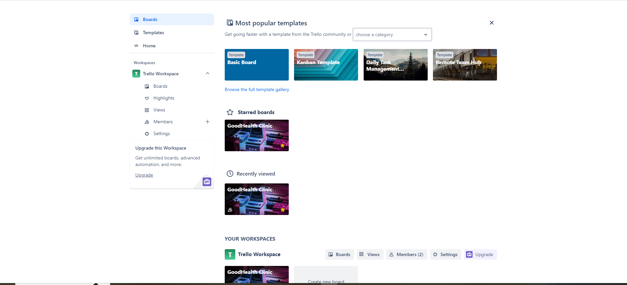
User Experience Design
Intuitive Interface
Customization Options
Mobile Compatibility
Easy navigation, minimizing the learning curve.
Personalize dashboard and notifications for better satisfaction.
Manage projects on the go, boosting remote productivity.

Slide 7

Security and Privacy
Data Encryption
User Access Control
Backup Features
All user data is encrypted, ensuring that sensitive project information remains secure.
Administrators can set different access levels for team members to restrict confidential information.
Automatic backups ensure that no data is lost and project histories can be retrieved if necessary.

Slide 8
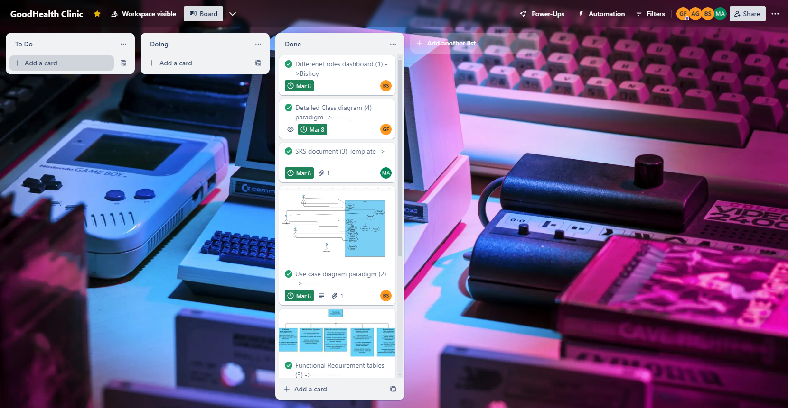

Slide 9




Conclusion
This project management tool combines the interaction dynamics of social media with functional project management features, creating an engaging, efficient, and collaborative environment for users to successfully manage their projects.
Engaging Environment
Efficient Management
Collaborative Experience
This tool integrates social media dynamics to enhance user engagement.
Functional features foster efficient project management.
Encourages teamwork for successful project outcomes.

